Slide 1
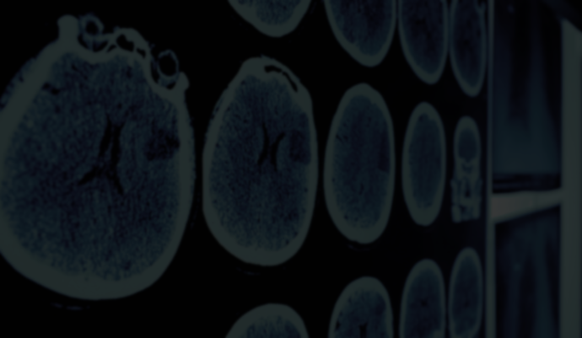
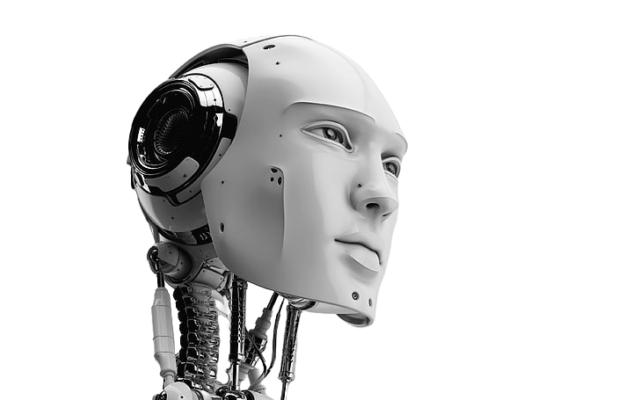
TITLE
ALBIN G KOSHY
ABHIYANK YADAV
VINIT KARLEKAR
TEJAS
AVADESH SHAH

Slide 2
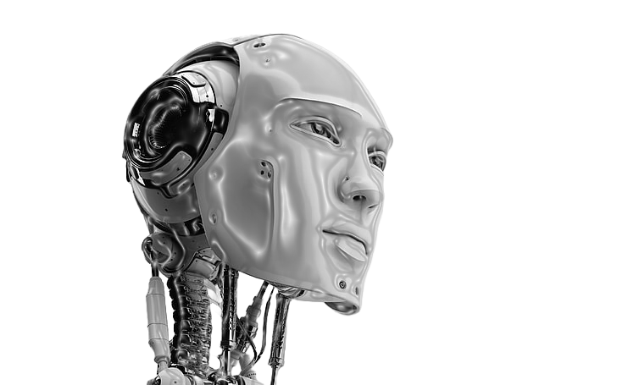

TEAM MEMBERS
The idea is to create an online platform which can assist users in identifying potential medical conditions based on their reported symptoms. The website utilizes advanced algorithms and machine learning technology to analyze user input and provide accurate medical guidance. Through a user-friendly interface, individuals can input their symptoms, receive a preliminary diagnosis, obtain relevant medical information, and access recommended treatments and nearby healthcare facilities.
ALBIN G KOSHY
ABHIYANK YADAV
VINIT KARLEKAR
TEJAS
AVADESH SHAH

Slide 3
ALBIN G KOSHY
ABHIYANK YADAV
VINIT KARLEKAR
TEJAS
AVADESH SHAH
INTRODUCTION
The idea is to create an online platform which can assist users in identifying potential medical conditions based on their reported symptoms. The website utilizes advanced algorithms and machine learning technology to analyze user input and provide accurate medical guidance. Through a user-friendly interface, individuals can input their symptoms, receive a preliminary diagnosis, obtain relevant medical information, and access recommended treatments and nearby healthcare facilities.
Key Features:
1. Symptom Input Interface: Users can input their symptoms through a simple and intuitive interface.
Disease Detection Algorithm: It employs a sophisticated algorithm powered by machine learning to analyze user-provided symptoms. The algorithm cross-references symptoms with a vast database of medical conditions to generate potential diagnoses
Preliminary Diagnosis and Medical Guidance: Based on the analysis, user receive a preliminary diagnosis along with detailed information about the identified medical condition. The platform offers guidance on potential causes, symptoms, risk factors, and available treatments for the diagnosed condition.
Medication Recommendations: It provides personalized recommendations for medications or treatments based on the diagnosed condition.
Hospital Locator: Users can access a hospital locator feature to find nearby healthcare facilities based on their location. The platform provides information about hospitals, clinics, and medical centre's where users can seek further evaluation or treatment.

Slide 4
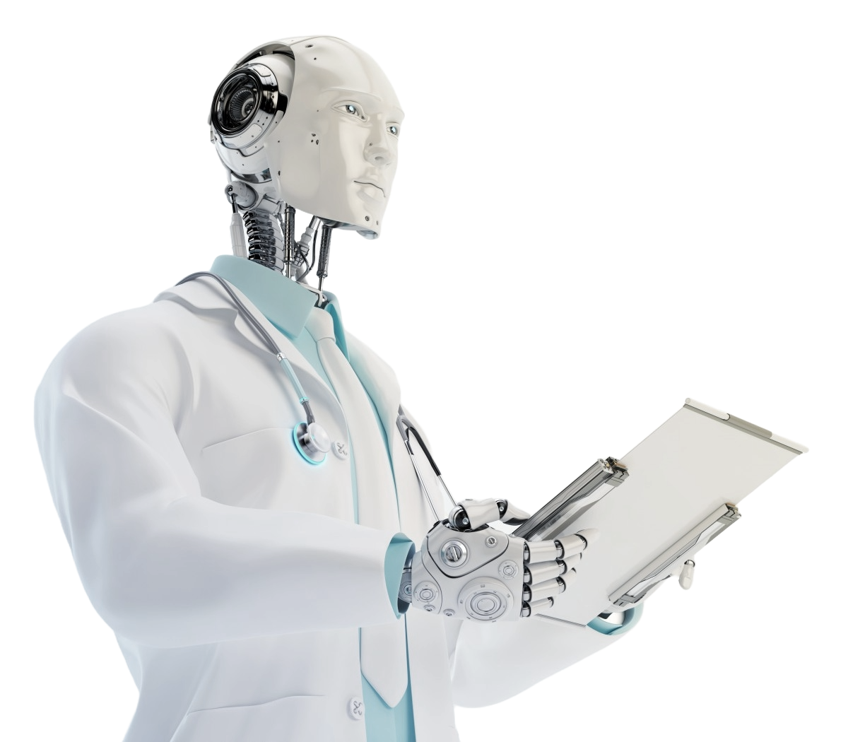
INTRODUCTION
The idea is to create an online platform which can assist users in identifying potential medical conditions based on their reported symptoms. The website utilizes advanced algorithms and machine learning technology to analyze user input and provide accurate medical guidance. Through a user-friendly interface, individuals can input their symptoms, receive a preliminary diagnosis, obtain relevant medical information, and access recommended treatments and nearby healthcare facilities.
Key Features:
1. Symptom Input Interface: Users can input their symptoms through a simple and intuitive interface.
Disease Detection Algorithm: It employs a sophisticated algorithm powered by machine learning to analyze user-provided symptoms. The algorithm cross-references symptoms with a vast database of medical conditions to generate potential diagnoses
Preliminary Diagnosis and Medical Guidance: Based on the analysis, user receive a preliminary diagnosis along with detailed information about the identified medical condition. The platform offers guidance on potential causes, symptoms, risk factors, and available treatments for the diagnosed condition.
Medication Recommendations: It provides personalized recommendations for medications or treatments based on the diagnosed condition.
Hospital Locator: Users can access a hospital locator feature to find nearby healthcare facilities based on their location. The platform provides information about hospitals, clinics, and medical centre's where users can seek further evaluation or treatment.

Slide 5

INTRODUCTION
Benefits:
Accessibility: Provides convenient access to medical guidance anytime, anywhere.
Empowerment: Empowers users to take proactive steps towards their healthcare.
Efficiency: Helps users save time by offering quick and accurate medical advice.
Peace of Mind: Offers reassurance and peace of mind by providing reliable information and guidance.
Target Audience:
-Individuals seeking preliminary medical advice for non-emergency symptoms.
-Those looking for convenient ways to identify potential medical conditions and explore treatment options.
-Caregivers or family members seeking information on behalf of others.
Objective: To develop a website that offers medical guidance based on user input of symptoms
Challenges: Providing accurate diagnosis and medication recommendations
Goal: Enhancing accessibility to medical advice and services

Slide 6


Machine learning in healthcare strategic management
By Sand Mohammad Salhout
This review has shed light on the remarkable growth of ML in healthcare institutions. Through bibliometric analysis and a comprehensive literature review, emerging trends, influential authors and key critical applications were identified.
INTRODUCTION
PROBLEM STATEMENT
Objective: To develop a website that offers medical guidance based on user input of symptoms
Challenges: Providing accurate diagnosis and medication recommendations
Goal: Enhancing accessibility to medical advice and services
Machine learning in medicine: a practical introduction
By Jenni A. M. Sidey-Gibbons & Chris J. Sidey-Gibbons
The approach which we have taken in this paper entails some notable strengths and weaknesses. We have chosen to use a publicly-available dataset which contains a relatively small number of inputs and cases. The data is arranged in such a way that will allow those trained in medical disciplines to easily draw parallels between familiar statistical and novel ML techniques.

Slide 7

LITERATURE REVIEW
Machine learning in healthcare strategic management
By Sand Mohammad Salhout
This review has shed light on the remarkable growth of ML in healthcare institutions. Through bibliometric analysis and a comprehensive literature review, emerging trends, influential authors and key critical applications were identified.
Machine learning in medicine: a practical introduction
By Jenni A. M. Sidey-Gibbons & Chris J. Sidey-Gibbons
The approach which we have taken in this paper entails some notable strengths and weaknesses. We have chosen to use a publicly-available dataset which contains a relatively small number of inputs and cases. The data is arranged in such a way that will allow those trained in medical disciplines to easily draw parallels between familiar statistical and novel ML techniques.
The proposed work involves the development of a user-friendly website interface where users can input their symptoms. Behind the scenes, machine learning algorithms will analyze these symptoms to detect potential diseases or medical conditions. Based on the analysis, the website will recommend appropriate medication from a curated database. Furthermore, the website will utilize location-based services to provide users with information about nearby hospitals or medical facilities where they can seek further medical assistance. Continuous refinement of the machine learning models and database will be undertaken to ensure accuracy and relevance of the recommendations provided.

Slide 8

Machine learning in medicine: a practical introduction
By Jenni A. M. Sidey-Gibbons & Chris J. Sidey-Gibbons
The approach which we have taken in this paper entails some notable strengths and weaknesses. We have chosen to use a publicly-available dataset which contains a relatively small number of inputs and cases. The data is arranged in such a way that will allow those trained in medical disciplines to easily draw parallels between familiar statistical and novel ML techniques.
PROPOSED WORK
In real-time usage, users will visit the website and input their symptoms through a simple and intuitive interface. The website will then process these symptoms using machine learning algorithms to generate potential disease diagnoses and medication recommendations. Users will receive instant feedback, enabling them to take proactive steps towards managing their health. Furthermore, the website will dynamically update information about nearby hospitals or medical facilities based on the user's location, ensuring timely access to medical assistance. Real-time usage of the website will provide users with convenient and reliable medical guidance, enhancing their overall healthcare experience.
The proposed work involves the development of a user-friendly website interface where users can input their symptoms. Behind the scenes, machine learning algorithms will analyze these symptoms to detect potential diseases or medical conditions. Based on the analysis, the website will recommend appropriate medication from a curated database. Furthermore, the website will utilize location-based services to provide users with information about nearby hospitals or medical facilities where they can seek further medical assistance. Continuous refinement of the machine learning models and database will be undertaken to ensure accuracy and relevance of the recommendations provided.
Machine learning in healthcare strategic management
By Sand Mohammad Salhout
This review has shed light on the remarkable growth of ML in healthcare institutions. Through bibliometric analysis and a comprehensive literature review, emerging trends, influential authors and key critical applications were identified.

Slide 9
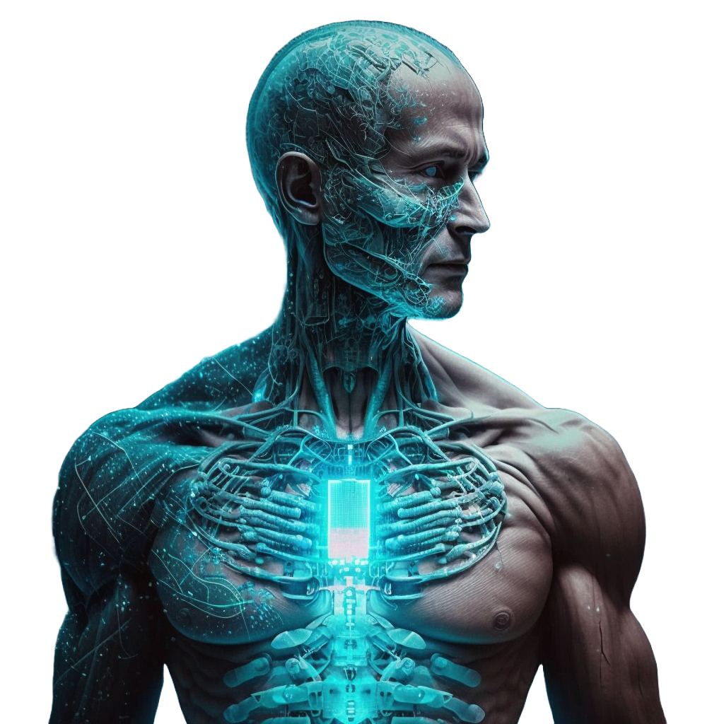
Server Infrastructure
The website requires a dedicated server with sufficient processing power and memory to handle the machine learning algorithms and user requests.
A reliable internet connection is essential to ensure smooth operation of the website.
REAL TIME USAGE
In real-time usage, users will visit the website and input their symptoms through a simple and intuitive interface. The website will then process these symptoms using machine learning algorithms to generate potential disease diagnoses and medication recommendations. Users will receive instant feedback, enabling them to take proactive steps towards managing their health. Furthermore, the website will dynamically update information about nearby hospitals or medical facilities based on the user's location, ensuring timely access to medical assistance. Real-time usage of the website will provide users with convenient and reliable medical guidance, enhancing their overall healthcare experience.
Technology Stack
The website is built using a combination of front-end and back-end technologies.
The front-end is developed using HTML, CSS, and JavaScript to create the user interface and handle user interactions.
The back-end is powered by Python and the Django framework, which handles the machine learning algorithms and data processing.
The website also utilizes a database management system, such as MySQL or PostgreSQL, to store user data and medical information.

Slide 10
In real-time usage, users will visit the website and input their symptoms through a simple and intuitive interface. The website will then process these symptoms using machine learning algorithms to generate potential disease diagnoses and medication recommendations. Users will receive instant feedback, enabling them to take proactive steps towards managing their health. Furthermore, the website will dynamically update information about nearby hospitals or medical facilities based on the user's location, ensuring timely access to medical assistance. Real-time usage of the website will provide users with convenient and reliable medical guidance, enhancing their overall healthcare experience.
HARDWARE & SOFTWARE REQUIREMENTS
Server Infrastructure
The website requires a dedicated server with sufficient processing power and memory to handle the machine learning algorithms and user requests.
A reliable internet connection is essential to ensure smooth operation of the website.
Technology Stack
The website is built using a combination of front-end and back-end technologies.
The front-end is developed using HTML, CSS, and JavaScript to create the user interface and handle user interactions.
The back-end is powered by Python and the Django framework, which handles the machine learning algorithms and data processing.
The website also utilizes a database management system, such as MySQL or PostgreSQL, to store user data and medical information.
User
Interface
Machine Learning Model
Database
APIs

Slide 11
OVERALL SYSTEM ARCHITECTURE DIAGRAM
Technology Stack
The website is built using a combination of front-end and back-end technologies.
The front-end is developed using HTML, CSS, and JavaScript to create the user interface and handle user interactions.
The back-end is powered by Python and the Django framework, which handles the machine learning algorithms and data processing.
The website also utilizes a database management system, such as MySQL or PostgreSQL, to store user data and medical information.
Machine Learning Model
User
Interface
Database
APIs
Server Infrastructure
The website requires a dedicated server with sufficient processing power and memory to handle the machine learning algorithms and user requests.
A reliable internet connection is essential to ensure smooth operation of the website.

Slide 12
MODULES & EXPLANATION
MODULE | PURPOSE | FUNCTIONALITY
User Registration | Allows users to create an account and access personalized features. | Collects user information and securely stores it for future use.
Symptom Checker | Helps users identify potential medical conditions based on their symptoms. | Uses machine learning algorithms to analyze user input and provide relevant suggestions.
Medical Database | Stores a comprehensive collection of medical information and resources. | Allows users to search for specific medical conditions, treatments, and medications.
Appointment Booking | Enables users to schedule appointments with healthcare professionals. | Displays available time slots and allows users to select and book appointments.
Health Tracker | Allows users to track their health metrics, such as blood pressure and heart rate. | Provides visualizations and insights based on the tracked data.
Health Tips | Provides users with informative articles and tips on maintaining a healthy lifestyle. | Offers guidance on nutrition, exercise, mental health, and more.
Machine Learning Model
User
Interface
Database
APIs

Slide 13
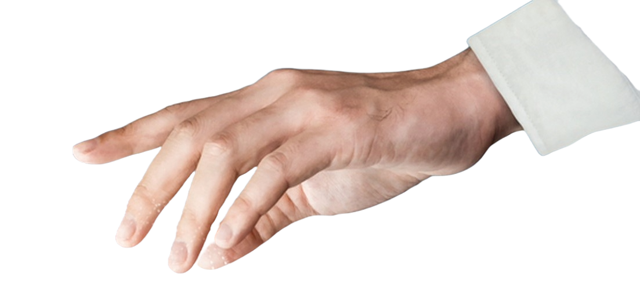
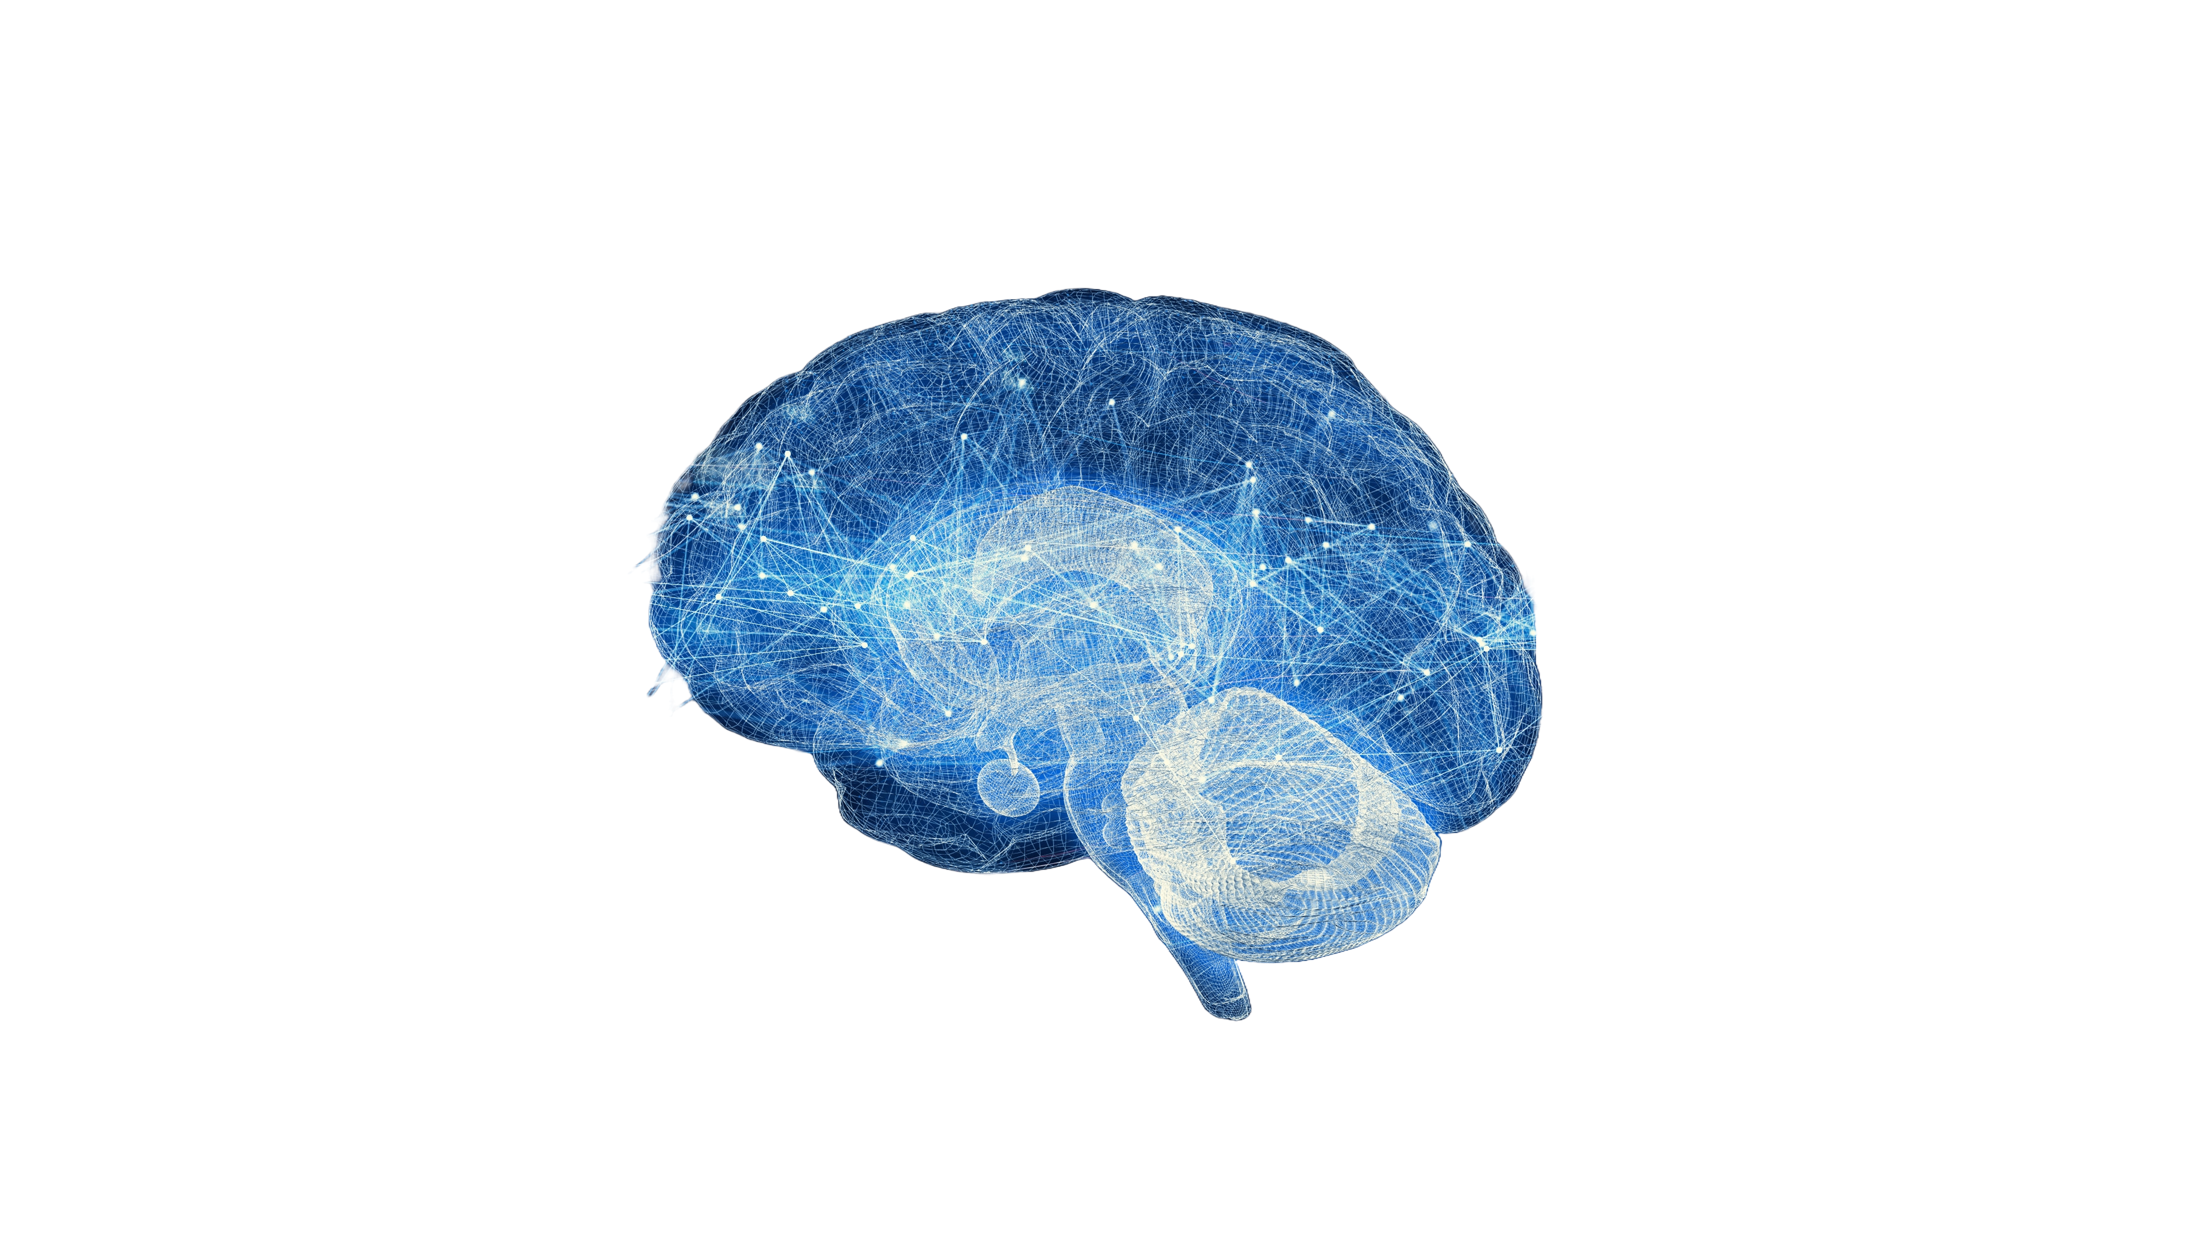

PROJECT TIMELINE CHART
https://chat.openai.com/
https://bmcmedresmethodol.biomedcentral.com/articles/10.1186/s12874-019-0681-4#Sec24
https://www.emerald.com/insight/content/doi/10.1108/AGJSR-06-2023-0252/full/html#sec006
https://tome.app/
https://www.kaggle.com/discussions/general/307498
https://www.coursera.org/
https://www.openml.org/

Slide 14
REFERENCES
https://chat.openai.com/
https://bmcmedresmethodol.biomedcentral.com/articles/10.1186/s12874-019-0681-4#Sec24
https://www.emerald.com/insight/content/doi/10.1108/AGJSR-06-2023-0252/full/html#sec006
https://tome.app/
https://www.kaggle.com/discussions/general/307498
https://www.coursera.org/
https://www.openml.org/

